Slide 1

Learning Git
Python for All
Class (TTS) Time 7 :00 pm to 9:00 pm

Slide 2

Version Control System??
You can think of a version control system (short: “VCS”) as a kind of “database”. It lets you save a snapshot of your complete project at any time you want. When you later take a look at an older snapshot (let's start calling it “version”), your VCS shows you exactly how it differed from the previous one.
*
§
Git
Helix VCS
Microsoft Team Foundation Server
Subversion
Rational Clear Case
*
TEAM FOUNDATION SERVER i i

Slide 3
Collaboration Storing Versions (Properly) Restoring Previous Versions Understanding What Happened Backup

Slide 4
Command Line or GUI?
There are two main ways of working with Git:
Command Line Interface (Bash)
GUI application. (Git Hub)
Neither of these are right or wrong.
On the one hand, using a GUI application will make you more efficient and let you access more advanced would be too complex on the command line.
On the other hand, however, I recommend learning the basics of Git on the command line, first. It helps you understanding of the underlying concepts and makes you independent from any specific GUI application.
features that form a deeper

Slide 5
Repository
“A kind of database where your VCS stores all the versions and metadata that accumulate in the course of your project.
- In Git, the repository is just a simple hidden folder named “.git” in the root directory of your project.
- Knowing that this folder exists is more than enough.

Slide 6
Local & Remote Repositories
There are two kinds of repositories:
A “local” repository resides on your local computer, as a “.git” folder inside your projecfs root folder. You are the only person that can work with this repository, by committing changes to it.
A “remote” repository, in contrast, is typically located on a remote server on the internet or in your local network. No actual working files are associated with a remote repository: it has no working directory but it exclusively consists of the “.git” repository folder. Teams are using remote repositories to share & exchange data: they serve as a common base where everybody can publish their own changes and receive changes from their teammates.

Slide 7
Commit
A commit is a wrapper for a specific set of changes.
Every set of changes implicitly creates a new, different version of your project.
Every commit also marks a specific version. Its a snapshot of your complete project at that certain point in time.
The commit knows exactly how all of your files and directories looked and can therefore be used, e.g., to restore the project to that certain state.

Slide 8
Some Very Basic Cheat Sheet
git config - -global user.email aghanhussain@gmail.com Git config - -global user.name “nasirhussain ’
1. Git init
2. Git add [filename. Ext] or git add . Or git add -A
3. Git status
4. Git commit -m “message’
3. Git remote add origin [repository name ]
6. Git push origin master
7. Git clone [repo name]
8. Git pull origin master

Slide 9
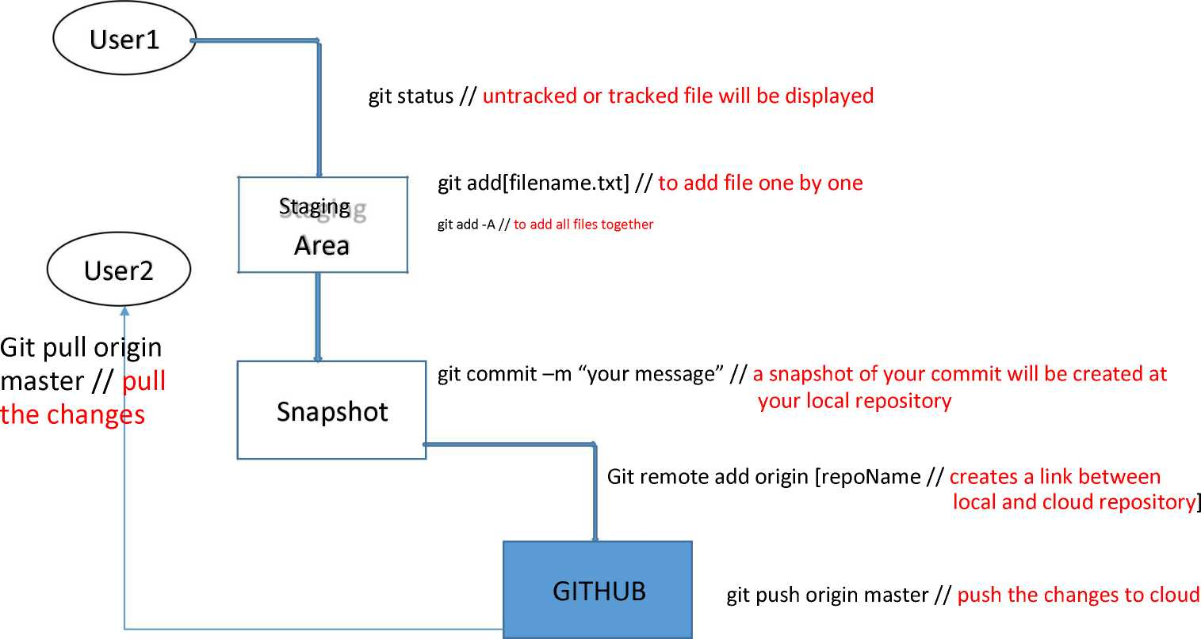
git init // a hidden folder will be created in root folder
Git clone [repo name]
// will clone the repo in same directory

Slide 10
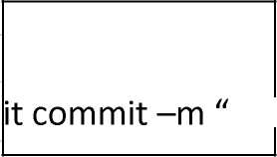
Filel
Snapshotl
Git commit -m "filel added"
Filel
File2
Snapshot2
Git commit -m
"file2 added"
Filel
Filel Snapshot3 G
file3 added" Filel

Slide 11


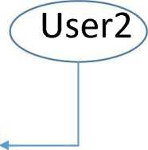
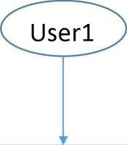

Branching & Merging
Branching is a process in which a repository is cloned for every developer coding in the project so that their changes on same time may not intersect.
Merging is a process in which both the clone repositories are merged and added to original so that their changes may reflect accordingly.
Userl
Repo
Master repo
User2
Clone Repo
Clone Repo
Repo

Slide 12
To check list of branch:
>>>git branch
Creating a new branch:
>>> git branch newBranch
Switch between branches:
>>> git checkout newBranch
Merging branches:
Load master branch first then
>>> git merge newBranch
Deleting braches:
>>>git branch -d newBranch

